Slide 1


AFFECTIVE ANALYSIS
BY: R. sai sathvik [1602-20-737-035]
B. Suresh kumar [1602-20-737-051]
m. Sai laxmi [1602-20-737-034]

Slide 2
MOTIVATION:
Humans can detect emotions from multiple domains for example speech and visual. Similarly a machine can also detect emotions by using proper machine learning and deep learning algorithms.
With advancement of deep learning technology there has been significant improvement of speech and video recognition.
Recognizing emotion from speech and video is important aspect and with deep learning technology emotion recognition has improved in accuracy and latency.

Slide 3
PROBLEM statement DESCRIPTION:
Through various modes such as audio and video different emotions such as anger, happiness, excitement, sadness, frustration, fear, surprise and neutral state are detected using deep learning algorithms.

Slide 4
ABSTRACT:
The primary objective of our project is to detect human emotions through machines similarly like how humans detect, which has become an essential requirement in the field of social intelligence, also increases the human-machine interactions.
The future generations of computers thus must be able to interact with a human being just like another.
There are still many challenges to improve accuracy. In this work, we attempt to explore different neural networks to improve accuracy of emotion recognition. With different architectures explored

Slide 5
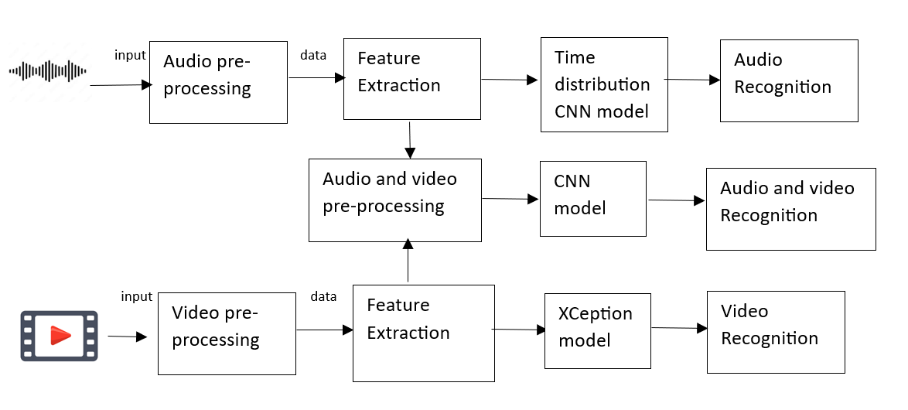
PROPOSED SOLUTION:

Slide 6

TECHNOLOGY STACK
Languages Required:
Backend: Python
Frameworks: Tensor Flow, Flask, Keras, Open CV2, Audiopy
Frontend: Html, CSS, JavaScript
Data set: CSV

Slide 7

IMPLEMENTATION:

Slide 8

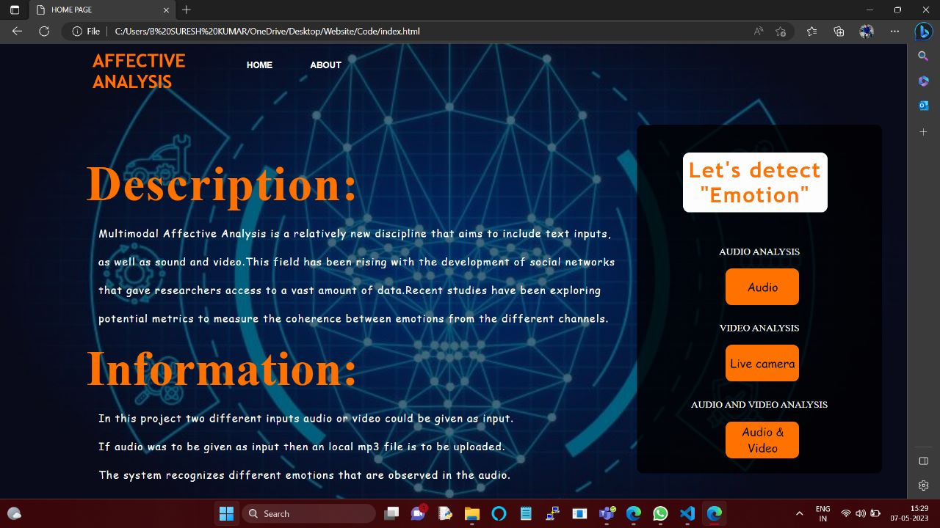

Slide 9
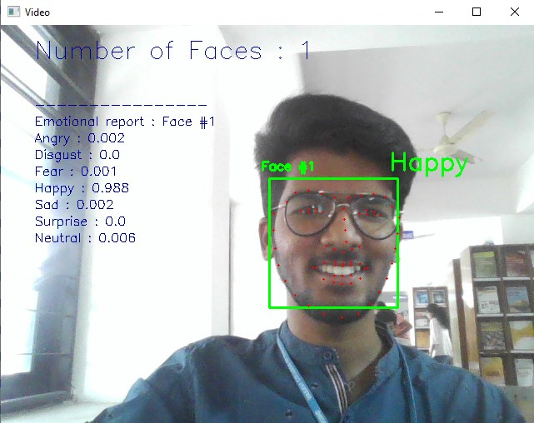

Slide 10
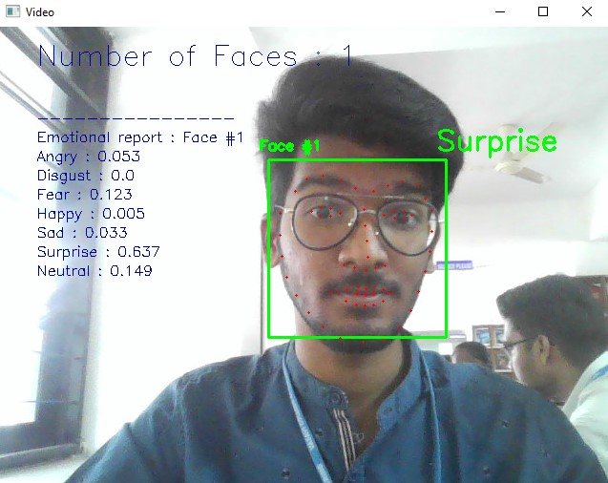

Slide 11
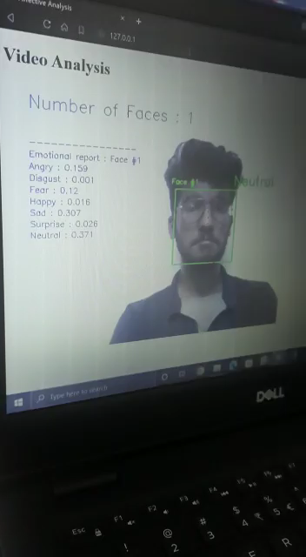
Sample video

Slide 12
PROS AND CONS
PROS:
Multi-Modal Approach: By utilizing both audio and video, an emotion recognizer can leverage multiple modalities to validate and reinforce emotional assessments.
Real-Time Analysis: Emotion recognition using audio and video can provide real-time analysis, allowing for immediate feedback and responses.
Contextual Understanding: The combination of audio and video data allows for a better understanding of the context in which emotions are expressed.

Slide 13
PROS AND CONS
CONS:
Privacy Concerns: Analyzing both audio and video data raises privacy concerns, as it involves capturing and processing personal information.
Technical Challenges: Analyzing audio and video data simultaneously requires advanced processing techniques and algorithms.
Environmental Factors: Audio and video data can be affected by various environmental factors, such as background noise, lighting conditions, camera quality, and recording equipment.

Slide 14
CONCLUSION & FUTURE SCOPE
Our project Affective Analysis helps to detect human emotions through machines by allowing user to record live video or audio, which increases the human-machine interactions.
This project has a future scope of increase in accuracy of detecting the emotions.
This project can also be extended to better accuracy by integrating human neural pulses and understand them further and improve it.

Slide 15
REFERENCES
https://www.overleaf.com/read/xvtrrfpvzwhf
The Ryerson Audio-Visual Database of Emotional Speech and Song (RAVDESS) | Zenodo
Challenges in Representation Learning: Facial Expression Recognition Challenge | Kaggle
https://github.com/maelfabien/Multimodal-Emotion-Recognition

Slide 16


